Slide 1

Topic for the class:Well-Posed Learning Problems Module -1: Title: Introduction Date & Time : 25 August 2020, 11AM-12PM
Dr. Sireesha Rodda
Professor
Department of Computer Science and Engineering
GITAM Institute of Technology (GIT)
Visakhapatnam – 530045
Email: srodda@gitam.edu

Slide 2

Course objectives
1. To understand the concepts of Machine Learning - Concept learning and Decision Trees
2. To gain an insight into Neural network learning and study of genetic algorithms.
3. To possess knowledge in Bayesian Learning
4. To explore the concept of Instance-based Learning.
5. To understand the inference and learning algorithms for Hidden Markov Model.

Slide 3
Learning Outcomes
At the end of the session, the students will be able to:
Identify tasks in real world which can be improved with the usage of machine learning techniques
Discuss the underlying assumptions as well a s issues inherent to machine learning
Define a machine learning problem formally as a well posed learning problem.

Slide 4
Machine Learning
The field of Machine Learning is concerned with the question of how to construct computer programs that automatically improve with experience
The purpose of this course is to present key algorithms and theory that form the core of Machine Learning

Slide 5
Machine Learning
Interdisciplinary nature of the material:
Statistics, Artificial Intelligence, Information Theory, etc.
Basic question:
How to program computers to learn?

Slide 6
Machine Learning
Intelligent Data Analysis:
Intelligent application of data analytic tools (Statistics)
Application of “intelligent” data analytic tools (Machine Learning)
Modern world: Data-driven world (industrial, commercial, financial, scientific activities)

Slide 7
Why Machine Learning?
Recent progress in algorithms and theory
Growing flood of online data
Computational power available

Slide 8
Why Machine Learning?
Niches for Machine Learning:
Data Mining: using historical data to improve decisions
Medical records → medical knowledge
Software applications we can’t program by hand
Autonomous driving
Speech recognition
Self customizing programs
Newsreader that learns user interests

Slide 9
Why Machine Learning?
Data Mining
Data: Recorded facts
Information: Set of patterns, or expectations, that underlie the data
Data Mining: Extraction of implicit, previously unknown, and potentially useful information from data
Machine Learning: Provides the technical basis of data mining

Slide 10
Why Machine Learning?
Typical Datamining Tasks
Risk of Emergency Cesarean Section
Given
9714 patient records, each describing a pregnancy and birth
Each patient record contains 215 features
Learn to predict:
Classes of patients at high risk for emergency cesarean section

Slide 11
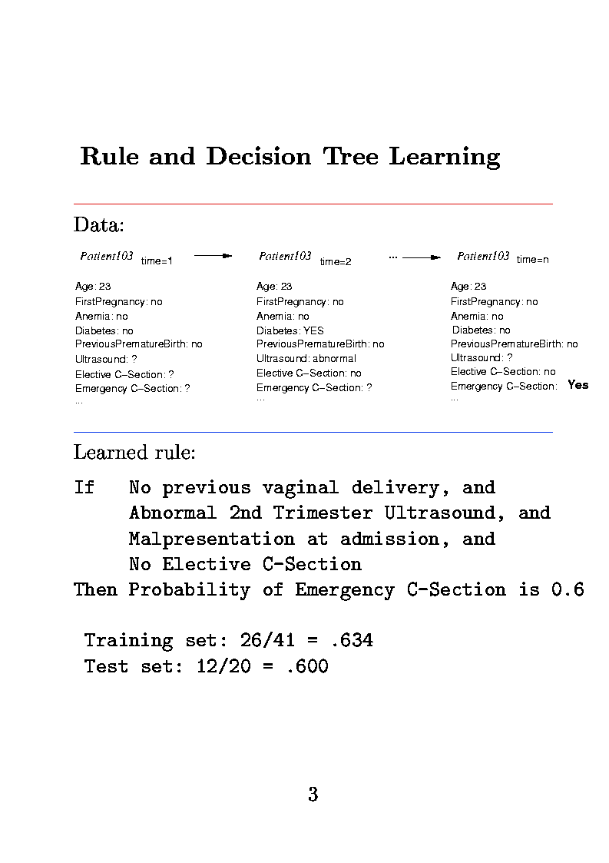
Why Machine Learning?

Slide 12
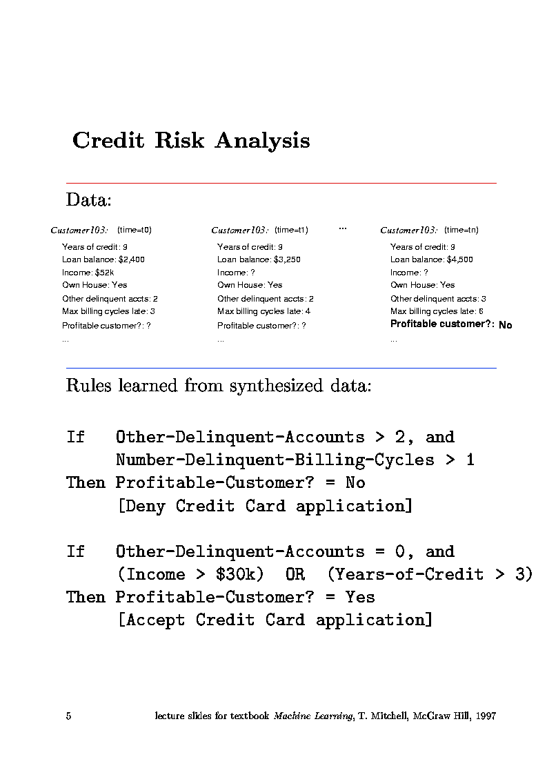
Why Machine Learning?
Credit Risk Analysis

Slide 13
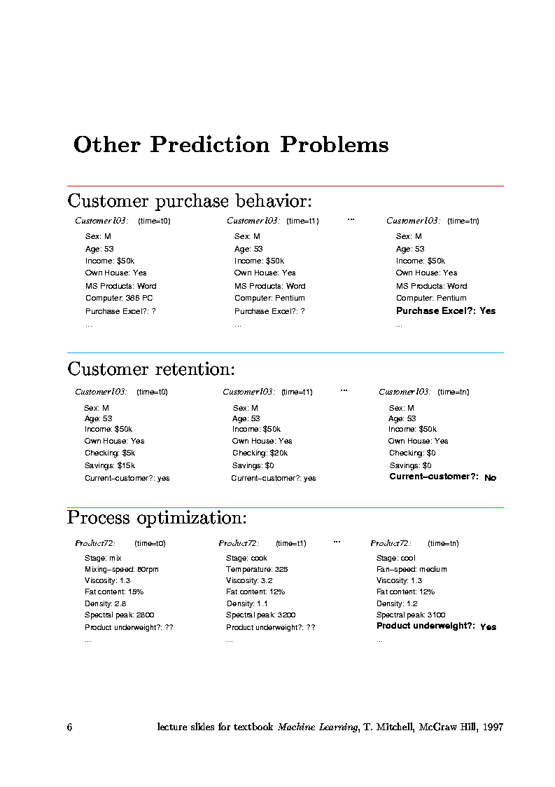
Why Machine Learning?
Customer Retention

Slide 14
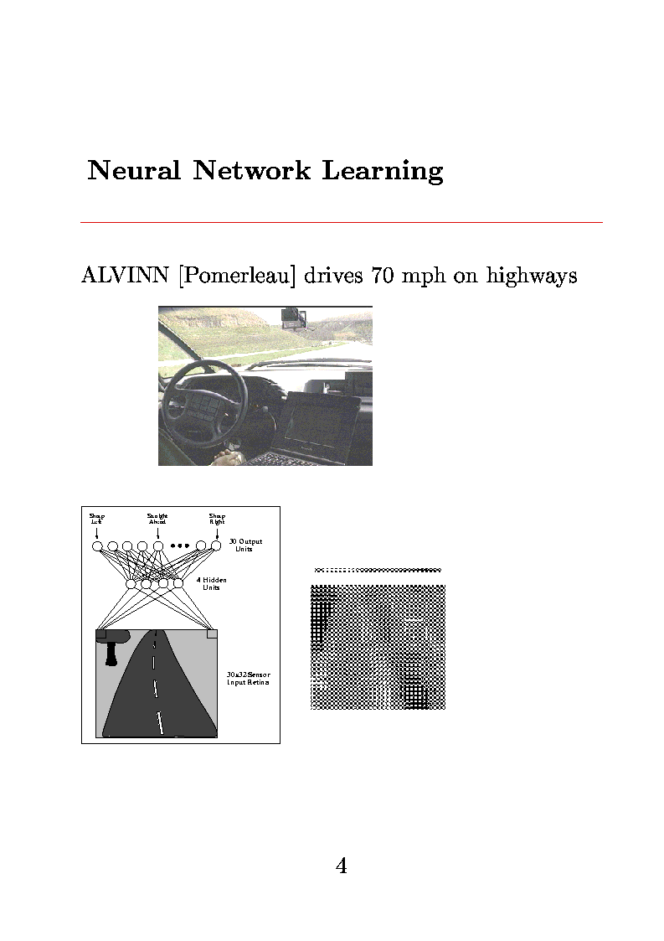
Why Machine Learning?
Problems Too Difficult to Program by Hand

Slide 15
What the future holds for Machine Learning
Today: tip of the iceberg
First-generation algorithms: neural nets, decision trees, regression....
Applied to well-formated databases
Tomorrow: enormous impact
Learn across mixed-media data and multiple databases
Learn by active experimentation
Learn decisions rather than predictions
Cumulative, life-long learning

Slide 16
Learning
How to program computers to learn?
Learning: Improving automatically with experience
Example: Computers learning from medical records which treatments are most effective for new diseases
Added value: Better understanding of human learning abilities

Slide 17
Well-posed Learning Problems
1.1 Well-Posed Learning Problems
Definition:
A computer program is said to learn from experience E with respect to some class of tasks T and performance measure P, if its performance at tasks in T, as measured by P, improves with experience E

Slide 18
An example well-posed learning problem
Example
Task T: Playing checkers
Training Experience E: Playing games against itself
Performance Measure P: Percentage of games won against opponents

Slide 19
Designing a Learning System
1.2 Designing a Learning System
Choosing the training experience:
Does the training experience provide direct or indirect feedback about the choices made about the choices made by the performance element?
Degree to which the learner controls the sequence of training examples
How well the training experience represents the distribution of examples over which “P” is measured.

Slide 20
Designing a Learning System
1.2 Designing a Learning System
Choosing the training experience: Does the training experience provide direct or indirect feedback about the choices made about the choices made by the performance element?
direct feedback
Mapping board states to correct moves
indirect feedback
Correctness of a move inferred from final outcome of a game

Slide 21
Designing a Learning System
1.2 Designing a Learning System
Choosing the training experience: Degree to which the learner controls the sequence of training examples
Learner replies on a teacher to select correct move
Learner itself proposes the correct move and asks teacher to verify
Learner h as complete control over board positions and training classifications.

Slide 22
Designing a Learning System
1.2 Designing a Learning System
Choosing the training experience: How well the training experience represents the distribution of examples over which “P” is measured.
Is distribution(training examples)==distribution(test examples)?
Checkers Problem: Choose
The exact type of knowledge to be learnt
Representation for the target knowledge
Learning mechanism

Slide 23
Designing a Learning System (contd..)
Choosing the target function
What type of knowledge will be learnt?
How will this be used by the performance element?

Slide 24
Designing a Learning System (contd..)
Choosing the target function
Legal moves are known a priori, but the best search strategy is not known
Target function: ChooseMove B → M
B: legal board states M: optimal legal move
Alternatively: Real function V : B → ℜ
V(b)=110 winning state, V(b)=-100 losing state, V(b)=0 match is drawn
Learning task: Discover an operational description of the ideal target function V (function approximation)

Slide 25
Designing a learning system
Choosing a Representation for the Target Function
The approximation function of V can be represented in any one of the following methods:
a large table with one entry per board position
Set of rules to be matched against board positions
A quadratic polynomial function
Or an artificial neural network
Tradeoffs of different representations: approximate function being as close as possible to V vs expressive function requiring more training data

Slide 26
Designing a learning system
Choosing a Representation for the Target Function
V(b) = w₀ + w₁ X₁ +...+ w₆ X₆
X_{1,2} : Number of black/red pieces on the board
X_{3,4} : Number of black/red kings on the board
X_{5,6} : Number of black/red pieces threatened (can be captured on red/black next turn)

Slide 27
Designing a Learning System (contd..)
Choosing a Function Approximation Algorithm
Training examples (b,V_{train}(b))
Rule for estimating training values: (scores or estimated values?)
V_{train}(b) ← V[Successor(b)]
Adjusting the Weights

Slide 28
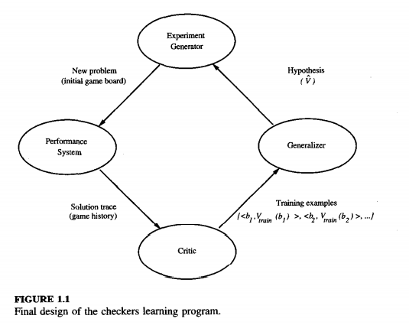
Final Design of Learning System

Slide 29
Final Design of Learning System
Performance System: solves performance task using learned target function
i/p: new problem
o/p:solution trace
Critic: module generates the training experience
i/p: solution trace
o/p:set o f training examples of the target function
Generalizer: The algorithm which takes specific training examples and generates an output hypothesis.
i/p: set of training examples
o/p:hypothesis as a function
Experiment Generator: Picks new practice problems that maximize learning rate of overall system
i/p: current hypothesis
o/p:new p roblem

Slide 30
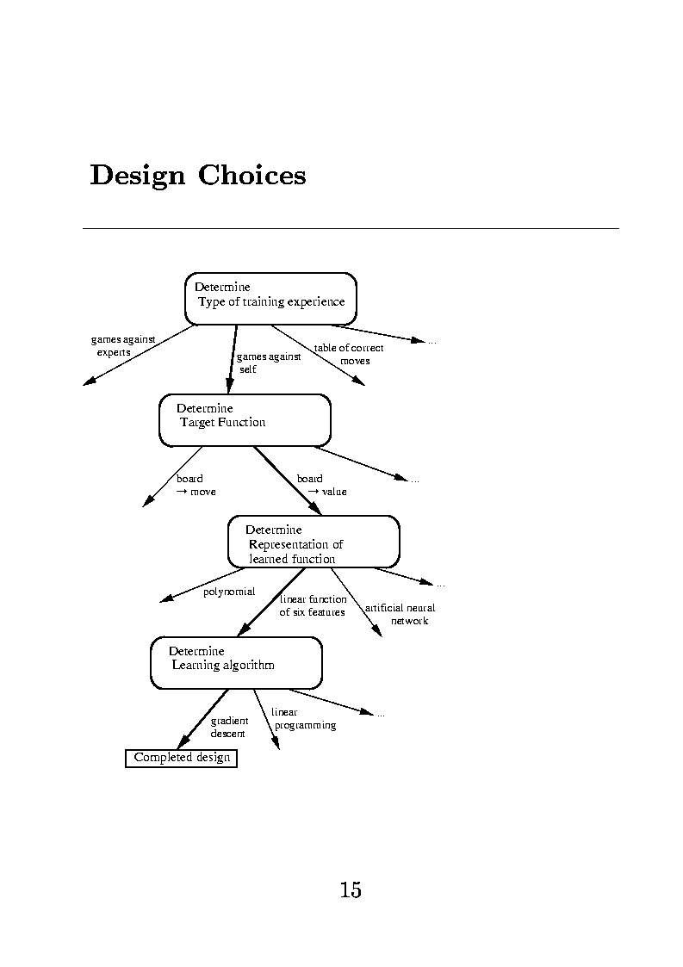
1. Introduction
Design Choices

Slide 31
1. Introduction
1.3 Some Issues in Machine Learning
What algorithms can approximate functions well (and when)?
How does number of training examples influence accuracy?
How does complexity of hypothesis representation impact it?
How does noisy data influence accuracy?
What clues can we get from biological learning systems?

Slide 32
Recap – Summary – What you have learnt
The evolution of machine learning over time
Real-time applications of machine learning
Defining a machine learning problem as a well posed learning problem

Slide 33
References
Machine Learning, Tom Mitchell (McGraw Hill, 1997)

Slide 34
THANK YOU

